Slide 1

Guided By Director
Dr. H. S. Fadewar Dr. G. V. Chowdhary

Slide 8
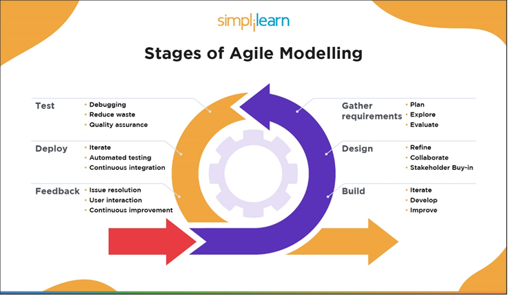

Slide 9
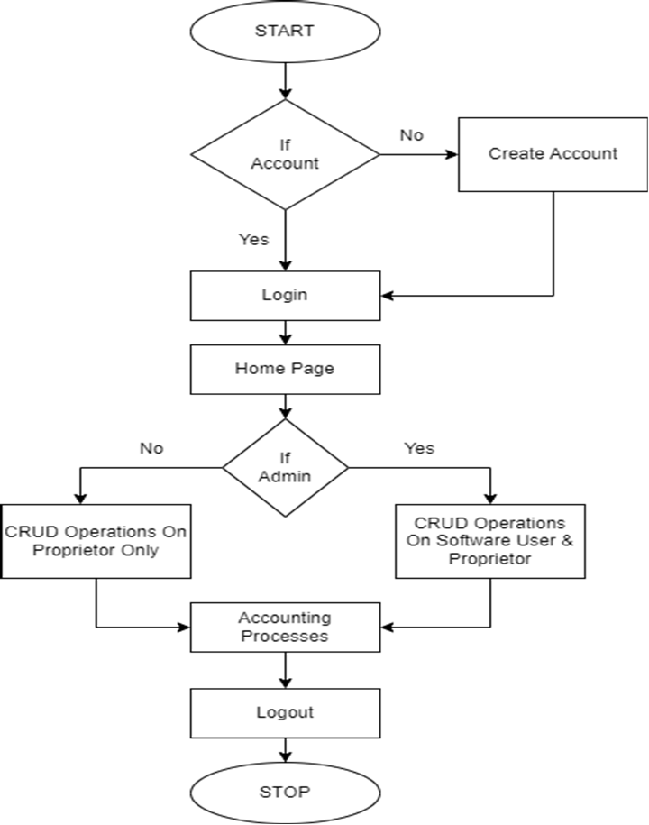
FLOW CHART

Slide 13
References
⇒ https://openai.com/
⇒ https://www.python.org/doc/
⇒ https://docs.djangoproject.com/en/4.1/
⇒ https://html.spec.whatwg.org/multipage/
⇒ https://getbootstrap.com/docs/5.3/getting-started/introduction/
⇒ https://developer.mozilla.org/en-US/docs/Web/JavaScript
⇒ http://myapmc.in/

